Slide 1
COST Fin AI Country Update- May 2024
Türkiye
Belma Öztürkkal, Pınar Nur, Ozgur YILDIRIM, Enis Kayış

Slide 2
Türkiye
MC Members:
Enis Kayış is Assistant Professor of Industrial Engineering at Ozyegin University
Related Research Interests: data driven decision making, XAI (i.e., optimal classification trees)
Belma Öztürkkal is Professor of Finance at Kadir Has University
Related Research Interests: venture capital, behavioral finance, corporate finance, ESG, mutual funds
Substitute MC Member:
Selçuk Karabatı is Professor of Operations Management at Koc University
Related Research Interests: finance, applied optimization in retail operations and supply chain management
Total 34 members (11 Female, 23 Male) for all Working Groups: WG 1, WG 2, WG 3
Responsibilities
Diversity Team (B. Öztürkkal, Pınar Nur, E. Kabaklarlı, M. Akar, G. Nur Yilmaz, G. Öztürk Danışman,)
Actions Planned:
  COST FinAI Meets Istanbul in May 2024
  Erasmus+ nextGen ESG application in 2023 to be revised with leadership of Maria Ioannario in October 2024
  Help create ties between researchers from Türkiye and our existing Action network

Slide 3
  COST FinAI Meets Istanbul, 20-21 May 2024
The conference took place in Otag-i Humayun, which is located as a historical building in Yildiz Technical University-Davutpasa Campus, Istanbul, Türkiye.
The presentations from WG1, WG2, WG3, and a Core group meeting on COST FinAI Topics were featured during a two-day event. All speakers and participants were from COST FinAI, with a focus on those with active participation.
There were 0.5 of a day talks including PhD presentations on topics related to WG1 and WG3. 0.25 day working session for drafting D7 a DP on the methodology used by P2P and crowdfunding regarding fraud detection.

Slide 4
Secondly, 0.25 of a day was allocated for Core group meeting and presenting the call for publications for an edited volume belonging to the event, 0.25 of a day for WG2 presentations, and 0.25 for working session on finalizing the paper for D7 involving all the COST members present and online.
This event has contributed to the reaching our Action's objectives of transparency in financial services and the development of conceptual and methodological tools for establishing when black-box models are admissible and, to the extent possible, making them more transparent and/or replacing them with interpretable and explainable models.
It has also contributed to the objective of creating an excellent network of researchers in Europe with lasting collaboration beyond the lifetime of the Action.
Participants from at least 5 countries from our members were involved in the organization and participated in the event and thus we ensured gender balance.

Slide 5
COST FinAI Istanbul Meeting at official social media accounts of Yildiz Technical University
https://x.com/YildizEdu/status/1793201926189826471
https://www.linkedin.com/posts/y%C4%B1ld%C4%B1z-teknik-%C3%BCniversitesi_internationalytu-internationalytu-activity-7198973952935751681-ehOL?utm_source=share&utm_medium=member_android
https://www.facebook.com/share/p/kmCydpLSfqDnz8Dt/?mibextid=xfxF2i
https://www.instagram.com/p/C7Q7gqQobzr/?igsh=MTFjY3d3b3Z1ZzFmZg%3D%3D&img_index=1

Slide 6
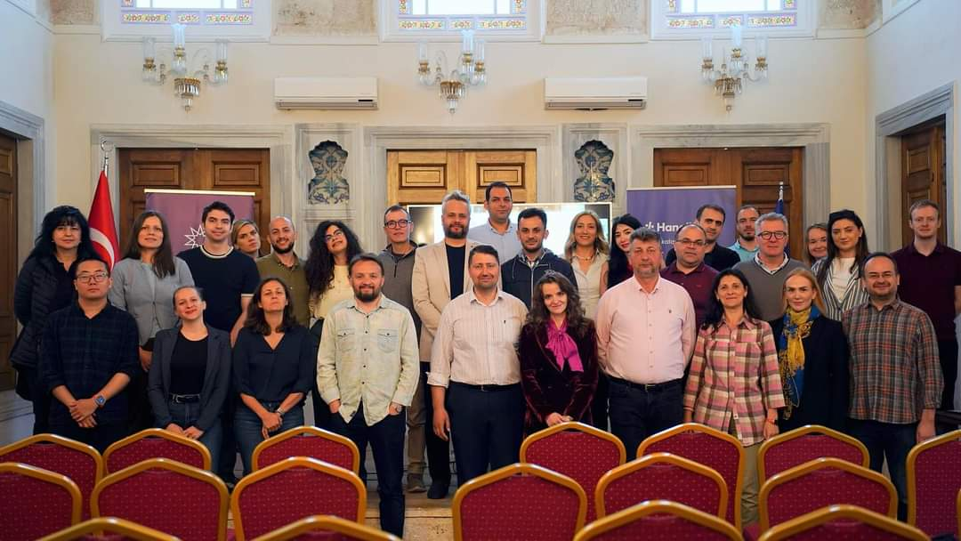

Slide 7
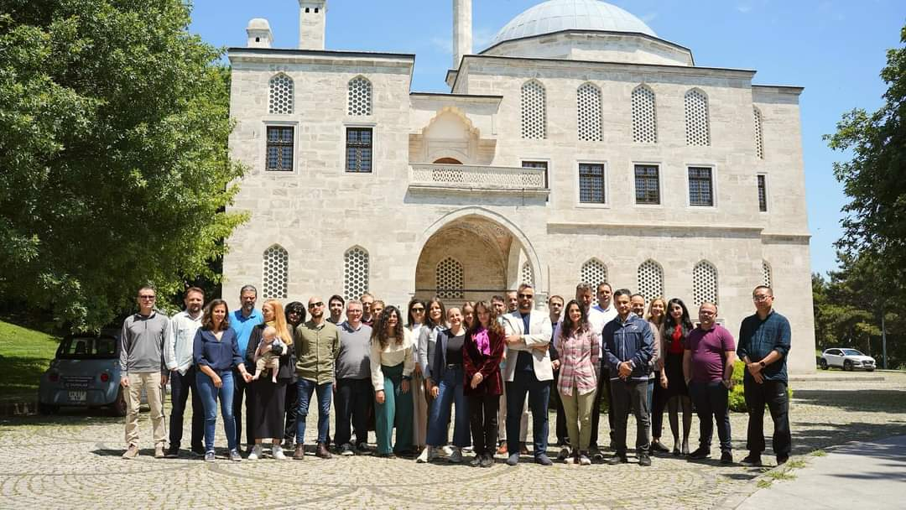

Slide 8
Türkiye
Members
Total 34 members (11 Female, 23 Male) for Working Groups WG 1, WG 2, WG 3
  Different fields (Finance, Law, Business, Economics, Engineering, Mathematics)
  MC Members:
Enis Kayış: Assistant Professor of Industrial Engineering at Ozyegin University
      ITC CG Coordinator, Core Group Member
Belma Öztürkkal: Professor of Finance at Kadir Has University
      Diversity Team Member
  Substitute MC Member:
    Selçuk Karabatı: Professor of Operations Management at Koc University
  Other Responsibilities
Diversity Team: Pınar Nur (Assistant Professor and Deputy Dean at Ankara Medipol University School of Law), Mutlu Akar, G. Nur Yilmaz (Professor and Head of the Department of Computer Engineering at TED University) Esra Kabaklarlı (Associate Professor of Economics Dept at Selçuk University),

Slide 9
Türkiye
Papers / Projects
Literature review paper WG2 - Sentiment analysis (ongoing 2021, B. Öztürkkal with other members)
Cross-country survey transparency, investors’ perception (second phase in 2023 October B. Öztürkkal with M. Iannario, C. Tarantola, S. Giordano, B. Bedowska)
Venture Capital Bibliometric Analysis and Systematic Review (will be submitted to JKE in 2024, B. Öztürkkal with P. Lameski, E. Zdravevski, A. Tanda, R. Wahlstrom, V. Trajkovik, C. Mare).
Women Editors (under review, revised and submitted to Journal of Business Ethics in 2023, B. Öztürkkal, B. Bedowska with other members)
Explaining mortgage defaults using SHAP and LASSO (under review, revised and submitted to Computational Economics in 2023, B. Öztürkkal with R. Wahlstrøm)
WG2 - Portfolio management Literature review paper (Frontiers in AI. published in April 2024, K. Sutiene, P. Schwendner, B. Öztürkkal with other members)
COST FinAI and COST DigiNET, Book Chapter, Springer, Impact of Financial Literacy Environmental, Social, and Governance (ESG), Saving and Borrowing Factors on Digital Experiences: A Multi-Country Survey Study Among the Elderly People (ongoing 2024. B. Öztürkkal with M. Iannario, C. Tarantola, A. Tanda, E. Kabaklarlı, R. Perri)
COST FinAI, Book Chapter, Springer or similar, D15. Zero Inflated Model Use with Survey Data of Italian Students. (ongoing 2024. B. Öztürkkal with M. Iannario, C. Tarantola, A. Tanda)
COST FinAI. Women in Fintech IV, Crete, Greece, presentation. B. Öztürkkal. A Multi-Country Survey Study Among the Elderly People
COST FinAI. B. Öztürkkal. Women in Fintech IV, Crete, Greece, Scientific Committee Member, Jury Member for Best WI-FI 2024 Young Researcher Award.

Slide 10
Papers / Projects
Machine Learning Framework to Price Setting Risk Averse Data-Driven Newsvendor Problem: NFT Portfolio Management (E. Atsiz, E. Kayış, E. Albey)
Rolling Look-Ahead Approaches for Optimal Classification Trees (under revision for IISE Transactions, B. Organ, E. Kayış and T. Khaniyev)
Green FinTech: Sustainability of Bitcoin (submitted to Digital Finance, E. Kabaklarlı)
Sustainable Innovation for Resilience and Efficiency Project, HORIZON-CL4-2024-RESILIENCE-01-41 with Codruta Mare and Rubin Haxhiymeri, Esra Kabaklarlı
Erasmus KA220-YOU - Cooperation partnerships in youth . Project title : Young Green Entrepreneurship Ecosystem , Iceland, Turkey, Italy (E. Kabaklarlı and Hanna Kristín Skaftadóttir)
Erasmus+ KA220 HD nextGen ESG Application in October-Fabruary 2023-2024 with leadership of Turkey with Ö. Yıldırım, B. Öztürkkal, Maria Ionnario, Albuena Shala, Alessia Paccagnini et al.

Slide 11
Türkiye
Papers / Projects
Discussion paper(s) on the methodology for evaluating/rating ICOs and crowdfunding/P2P platforms and for detection/early warning about fraud/illegal behaviour with emphasis on the application of AI tools as part of D7 (contributed by Gökçe Nur Yılmaz, Nadi Serhan Aydın, Pınar Nur, Eda Orhun and Esra Kabaklarlı)
Methodological discussion paper on AI models to generate “failed trials” of investment product producers and on quantitative strategies with the usage of the promising field of network data analysis as part of D12 (contributed by Mutlu Akar and Nadi Serhan Aydın)

Slide 12
Networking
COST Virtual Mobility Grant,CA19130, Cross-country survey transparency, investors’ perception (2021- B. Öztürkkal with G. Pisoni, A. Tanda, P. Schwendner).
COST Virtual Mobility Grant,CA19130, Venture Capital Bibliometric Analysis and Systematic Review (2022 - B. Öztürkkal with P. Lameski, E. Zdravevski, A. Tanda, R. Wahlstrom, V. Trajkovik, C. Mare).
COST Virtual Mobility Grant,CA19130, Bitcoin Mining and Its Environmental Effects; Nexus of Green FinTech, 01 September 2021- 01 October 2021 Esra Kabaklarlı.
COST Virtual Mobility Grant CA19130 The Role of FinTech in Cashless Economy and Green Growth, 27/09/2022-06/10/2022 Esra Kabaklarlı.
COST FinAI Summer School 2023, Data Science For Sustainable Finance And Economics, Role of Green Fintech in Promoting Economic Growth, Evidence From The OECD Countries : Panel Data Analysis, Esra Kabaklarlı
“A Machine Learning Method for Asset Allocation: Nodewise Regression”, A. Özlem Önder, January 15, online seminer for the COST CA19130 Members.

Slide 13
Türkiye
Future Plans
COST FinAI. Women in Fintech IV, Crete, Greece, presentation. Pınar Nur and G. Nur Yilmaz. AI and Generative AI Based Transfer Pricing Tax Transparency
COST FinAI Book chapter on the Edited Volume on scientific achievements of the action CA19103. «Taxation of the Crowdfunding Platforms» (Pınar Nur), «Best practices of the integration of AI and generative AI for transparency in FinTech» (Gökçe Nur Yılmaz).
COST FinAI. Gran Canaria, Spain, presentation. B. Öztürkkal. Fintech Report: Türkiye. AI in finance and society - challenges and opportunities
Second Phase of Erasmus+ in October 2024 nextGen ESG after application with leadership of Italy in 2024. with M. Iannario, Ö. Yıldırım, M. Akar, B. Öztürkkal
Help create ties between researchers from Türkiye and our existing Action network
Inclusion of some of Türkiye s leading fintech companies (Sigortam.net, HangiKredi) in the action
COST FinAI and COST DigiNET, Book Chapter, Springer, Impact of Financial Literacy Environmental, Social, and Governance (ESG), Saving and Borrowing Factors on Digital Experiences: A Multi-Country Survey Study Among the Elderly People (ongoing 2024. B. Öztürkkal with M. Iannario, C. Tarantola, A. Tanda, E. Kabaklarlı, R. Perri)
COST FinAI, Book Chapter, Springer or similar, D15. Zero Inflated Model Use with Survey Data of Italian Students. (ongoing 2024. B. Öztürkkal with M. Iannario, C. Tarantola, A. Tanda)

Slide 14
Türkiye
Members
Prof.Dr.Ahmet ALKAN, WG 2
Prof. Mutlu AKAR, WG 2
Prof Ozgur YILDIRIM, WG 2
Dr. Seda TURK, WG 2
Prof. Belma OZTURKKAL, WG 2, WG 3
Prof. Gokce Nur YILMAZ, WG 2
Prof. Ismail KIRBAS, WG 1, WG 2, WG 3
Asst. Prof. Pınar Nur WG 1, WG 2, WG 3
Dr. Gamze OZTURK DANISMAN, WG 1, WG 2, WG 3
Mr. Bekir BERKCAN, WG 1, WG 2
Dr. Alper OZCAN, WG 1, WG 2, WG 3
Dr. Sinan HANAY, WG 1, WG 2, WG 3
Prof. Melike BILDIRICI, WG 1, WG 2
Associate Prof. Esra KABAKLARLI, WG 1, WG 3
Prof. Enis KAYIS, WG 1, WG 2
Dr. Bertaç Şakir ŞAHİN WG1, WG2, WG3
Prof. Sadettin Haluk Çitçi WG3
Dr. Bekir CETINTAV, WG1, WG2
Mr. Ferit BUYUKKECİCİ, WG1, WG2
Prof. Gizay Daver, WG2,WG3
Prof A. Özlem Önder WG3
Asst. Prof. N. Serhan Aydın, WG3

